Slide 1

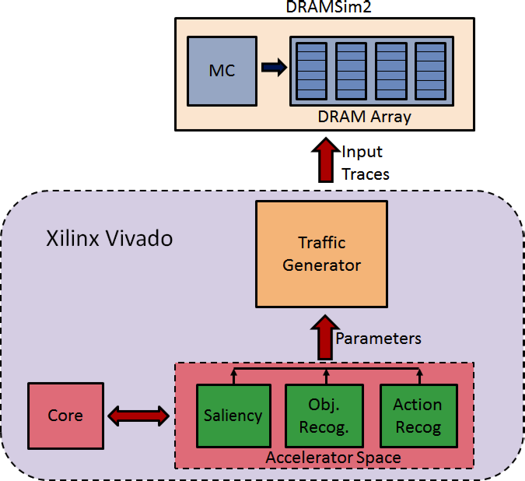
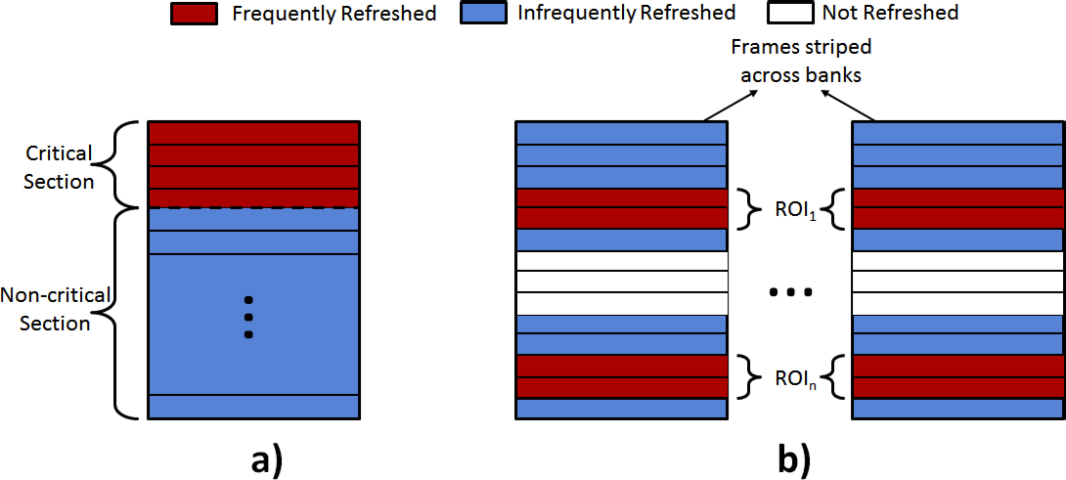
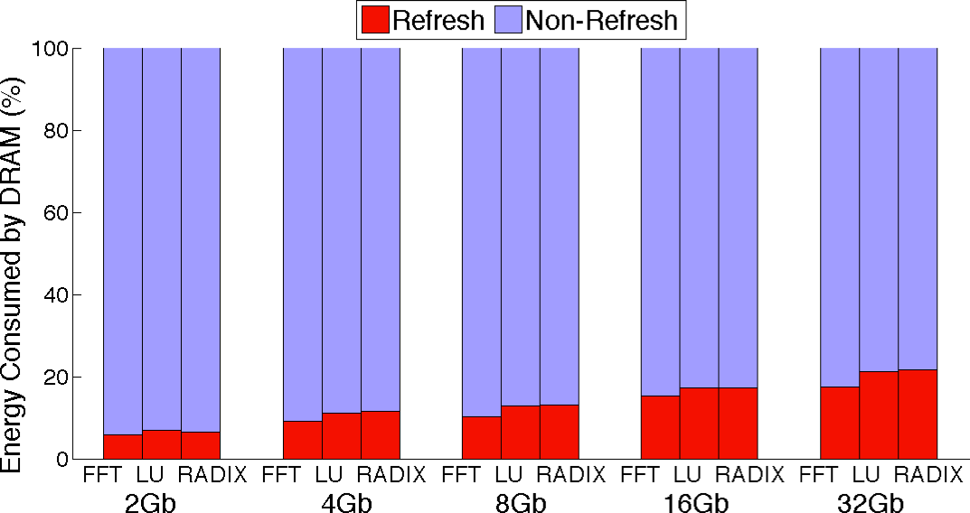
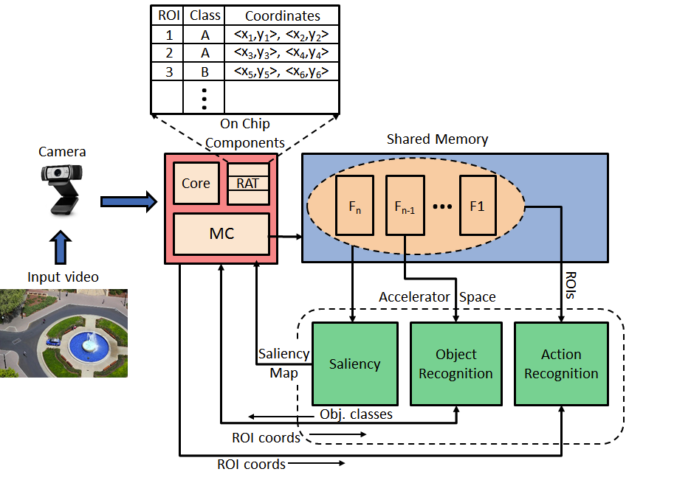




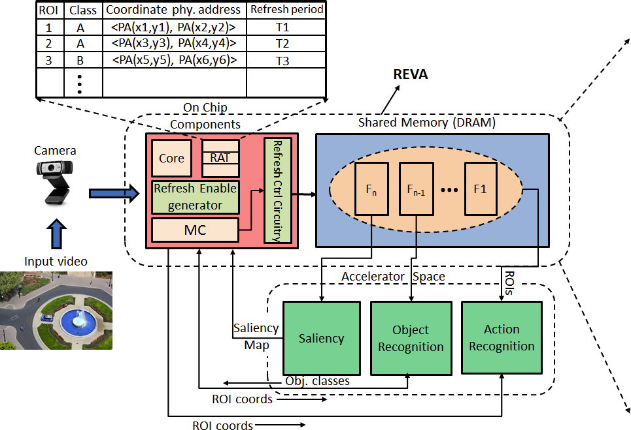
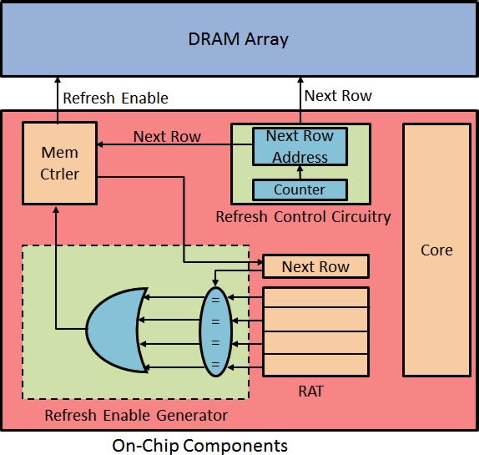








REFRESH ENABLED VIDEO ANALYTICS (REVA) : IMPLICATONS ON POWER AND PERFORMANCE OF DRAM SUPPORTED EMBEDDED VISUAL SYSTEMS
Siddharth Advani¹, Nandhini Chandramoorthy¹, Karthik Swaminathan¹, Kevin Irick², Yong Cheol Peter Cho³, Jack Sampson¹ and Vijaykrishnan Narayanan¹
¹The Pennsylvania State University, ²SiliconScapes LLC, ³ETRI, South Korea
Introduction
Experimental Setup
Results
Wearable video systems require capabilities for real-time video analytics and prolonged battery lifetimes for wide adoption.
Application-specific video accelerators have shown to be extremely efficient in terms of power and performance to handle real-time workloads.
However, the memory system contributes between 10-30% of the overall power of embedded video systems and mobile phones. In particular, the refresh power in DRAMs has become a major source of concern and continues to increase with every new generation of devices.
We propose a Refresh Enabled Video Analytics (REVA) system that reduces refresh power by using semantic knowledge to modulate the refresh periods at a row-level granularity.
We consider a detection-object recognition-
action recognition pipeline for visual scene understanding.
We used Vivado to generate memory
traces based on our accelerator
parameters.
These traces act as input to
DRAMSim2 to enable
power modeling.
Our evaluations were on a 8 Gb
single rank DDR3-1600 device.
Flikker
REVA
Motivation
DRAM row buffer policy | Open page, Closed after four accesses
DRAM Configuration | DDR3-1600, 8 Gb, 1 channel, 1 rank, 8 banks/rank
Timing parameters (ns) | t_{RP} = 11, tRCD = 11, tRFC = 350, tREFI = 7800
Current parameters (mA) | I_{DD0} = 110, I_{DD1} = 135, I_{DD2P} = I_{DD2Q} = 40, I_{DD2N} = 42, I_{DD3N} = 45, I_{DD4W} = 280, I_{DD4N} = 270, I_{DD5} = 215, I_{DD6} = 12
We compare REVA with state-of-the-art architectures like Flikker. Other refresh related work includes RAIDR and Elastic Refresh but is orthogonal to our approach.
REVA is dynamically capable of changing the refresh value of an RoI, by simply modifying the refresh period in the corresponding RAT entry.
This avoids any additional writes
needed to re-write the RoI into
frequently refreshed memory.
The expected gains from
REVA’s finer grained approach
always provide at least
as much power savings as Flikker
while being feasible for a larger
set of tasks.
Sensitivity Analysis
In a purely streaming embedded system refresh can be turned off completely. However, there can be instances when a burst of RoIs is generated and the pipeline cannot sustain a high throughput.
RoIs will then be needed to be buffered.
In action recognition consecutive
RoIs are used for classification.
We evaluated different configurations
of action recognition on the
Weizmann dataset. The results
indicate that a purely
streaming (no overlap of video
segments) configuration affects
accuracy considerably (by around 10%).
tRFC trends
System Architecture
Refresh energy distribution in Kernel computations
Baseline
Conclusions
We demonstrate a Refresh Enabled Video Analytics system, which is tuned to optimize energy utilization of the memory by exploiting data characteristics in vision-based applications. We show that depending on the RoI stored in memory, the need for refresh varies from row to row across each memory bank. By adjusting refresh rates selectively depending on the need for re-use of different RoIs, we demonstrate 88% improvement in refresh power and 15% improvement in overall power over existing DRAM schemes.
Person 1 - Walk
Person 2 - Skip
Person 3 - Wave
Person 4 - Jump
Video Stream
Frame 1
REVA Architecture
References
[1] S. Liu, Pattabiraman K., T. Moscibroda, and B. Zorn, “Flikker:Saving DRAM Refresh-power through Critical Data Partitioning,” in ASLPOS, 2011.
[2] J. Liu, B. Jaiyen, R. Veras, and O. Mutlu, “RAIDR: Retention-Aware Intelligent DRAM Refresh,” in ISCA, 2012.
[3] J. Stuecheli, D. Kaseridis, H. Hunter, and L. John, “Elastic Refresh: Techniques to Mitigate Refresh Penalties in High Density Memory,” in MICRO, 2010.
[4] R. Peters and L. Itti, “Applying computational tools to predict gaze direction in interactive visual environments,” ACM Trans. on Applied Perception, 2007.
[5] J. Mutch and D. G. Lowe, “Object class recognition and localization using sparse features with limited receptive fields,” IJCV, 2008.
[6] H. Jhuang, T. Serre, L. Wolf, and T. Poggio, “A biologically inspired system for action recognition,” in ICCV, 2007.
Frame 20
Frame 40
This work was supported in part by NSF Expeditions in Computing Award 1317560, and NSF award 1213052. The work was also supported by infrastructure provided by NSF Award 1205618. This work was partly supported by the IT R&D program of MOTIE/KEIT 1004884 Automotive ECU SoC and Embedded SW for Multi-domain Integration.

